Slide 1
Bank Account Fraud Detection Using Machine Learning
Group Members
Narendra Reddy Reddymalla – 700743852
Akhil Patlori - 700744211
Vikram Boppana - 700742246

Slide 2
Contributions
Individual Contributions | Activities
Vikram Boppana | Selecting the dataset required for analysis. Removing complex datasets from consideration. Organizing the selected dataset as necessary for further analysis.
Narendra Reddy Reddymalla | Arranging the data in the desired format for analysis. Creating graphical representations of the data through data visualisation techniques Analyzing the data visually and identifying trends or patterns
Akhil Patlori | Implementing machine learning techniques and algorithms for predictions Defining and fine-tuning the machine learning model for accurate predictions Evaluating the performance of the prediction model and making necessary adjustments.

Slide 3
Motivation
The motivation behind the Bank Account Fraud (BAF) dataset and the analysis conducted on it using machine learning techniques can be summarized as follows:
Protecting Financial Institutions: Fraudsters pose a significant risk to banking services by exploiting identities and creating fake individuals. Detecting and preventing fraud is crucial to safeguard financial institutions and minimize losses.
Leveraging Machine Learning: Machine learning plays a vital role in fraud detection, enabling faster and more efficient identification of fraudulent applications. By using machine learning models, banks can automate the process and enhance their ability to combat fraud.
Ensuring Social Rights: Having a bank account is considered a fundamental right. Detecting fraud is socially significant as it protects individuals' interests and ensures fair access to banking services.

Slide 4
Objectives
The primary objective of BAF is to address the significant risks associated with bank account fraud by leveraging machine learning techniques. By detecting fraudulent applications, banks can reject them, preventing unauthorized access to banking services and protecting customers from potential financial losses.
Also, to ensure fairness in machine learning predictions. Biased decision-making can have negative consequences, and thus, banks and merchants are adopting fair ML methods to mitigate any biases and provide equal opportunities to all applicants while maintaining effective fraud detection.
With the BAF dataset, the objective is to perform various types of analysis including descriptive, prescriptive and predictive analysis , the dataset provides valuable insights for developing fraud detection models in the banking industry.

Slide 5
Related work
Fraud Detection Research: Prior work has focused on developing ML models to detect fraudulent bank account applications and mitigate financial risks.
Fairness in Fraud Detection: Concerns about biased decision-making have prompted the adoption of fair ML methods in the banking sector.
Tabular Data Analysis Gap: While progress has been made in computer vision and NLP, the analysis of tabular data, common in banking, has lagged. BAF dataset bridges this gap.
Enhancing Fraud Detection: BAF dataset provides a comprehensive platform to evaluate and enhance ML techniques for fraud detection, ensuring fairness and accuracy in predictions.

Slide 6
Problem Statement
Detecting and preventing bank account fraud is a critical challenge.
Existing methods lack comprehensive and accurate models for analyzing tabular data, necessitating the need for innovative and privacy-preserving datasets like BAF to enhance fraud detection techniques.

Slide 7
Proposed solutions
It will begin from the principal segment and investigate every section and comprehend what influence it makes on the objective segment.
At the necessary step, we will likewise perform preprocessing and include designing undertakings.
The point in acting top to bottom exploratory examination is to get ready and clean information for better machine learning demonstrating to accomplish elite execution and summed up models.

Slide 8
Continued…
It should begin with breaking down and setting up the dataset for expectation.
Modules:
Dataset collection
Data preparation
Model Development
Exploratory Data Analysis
Outlier Analysis
Machine learning Modeling
Evaluation

Slide 9
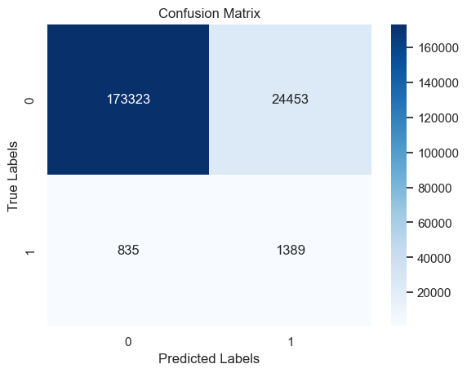
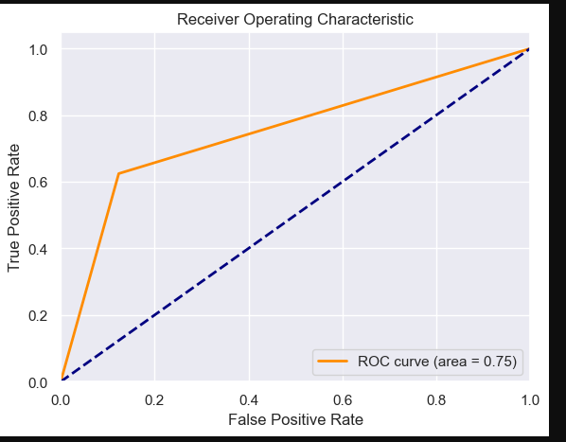
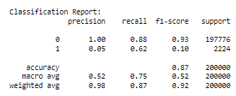
Results:
After evaluating various models, below ones demonstrate the performed metrics using Balance badging model

Slide 10
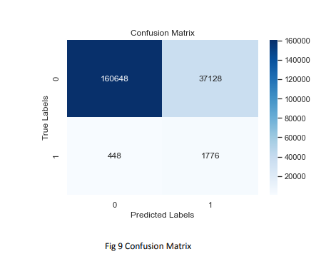
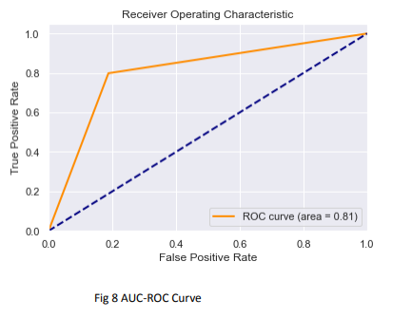
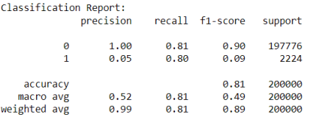
Results:
After evaluating various models, easy Ensemble model emerged as the top performer, demonstrating the following performed metrics.

Slide 11
References
https://pubmed.ncbi.nlm.nih.gov/11376540/
https://ieeexplore.ieee.org/stamp/stamp.jsp?arnumber=9999220
https://journalofbigdata.springeropen.com/articles/10.1186/s40537-022-00573-8
https://www.irjmets.com/uploadedfiles/paper//issue_1_january_2022/18561/final/fin_irjmets1643111967.pdf
https://www.researchgate.net/publication/227441142_Logistic_regression_in_data_analysis_An_overview
Hanley J, McNeil B. A method of comparing the areas under receiver operating characteristic curves derived from the same cases. Radiology 1983;148:839–43.
Harrell F, Lee K, Mark D. Multivariable prognostic models: issues in developing models, evaluation assumptions and adequacy, and measuring and reducing errors. Stat Med 1996;15:361– 87.

Slide 12
To be Continued…
Phua, C., Alahakoon, Damminda, Lee, Vincent: Minority report in fraud detection: classification of skewed data. ACM SIGKDD Explor. Newsl. 6, 50–59 (2004)
https://arxiv.org/abs/2101.08030
Allen D. The relationship between variable selection and data augmentation and a method of prediction. Technometric 1977;16:125–7
Pérez, J.M., Muguerza, J., Arbelaitz, O., Gurrutxaga, I., Martín, J.I.: Consolidated tree classifier learning in a car insurance fraud detection domain with class imbalance. In: Pattern Recognition and Data Mining (ed), pp. 381–389. Springer (2005)
Phua, C., Alahakoon, D., Lee, V.: Minority report in fraud detection: classification of skewed data. ACM SIGKDD Explor. Newsl. 6, 50–59 (2004)
https://www.sciencedirect.com/science/article/abs/pii/S0952197619302714
http://www.cs.put.poznan.pl/jstefanowski/pub/ABBag2017.pdf
https://www.researchgate.net/publication/220198530_Roughly_balanced_Bagging_for_Imbalanced_data

